Slide 1


Predicting Hotel Booking Cancellations
OTM 714 – Supply Chain Analytics – Final Project
Team Members: Karan Modi, Folarin Omotoriogun, Mark Tegeler, Shih-Yuan Wang, Yujie Wen
Professor: Greg DeCroix

Slide 2





Team
Karan Modi
Folarin Omotoriogun
Mark Tegeler
Shih-Yuan Wang
Yujie Wen
MBA Operations & Technology Management
MBA Operations & Technology Management
MS in Supply Chain Management
MS in Business Analytics
MS in Business Analytics

Slide 3

Outline
1. Introduction
2. Business Objectives
3. Data Exploration - Tableau Observations
4. Data Manipulation
5. Predictive Models
Association Rules
Logistic Regression
Classification Trees
K-Nearest Neighbors
Random Forests
Evaluation of Models
6. Recommendations
7. Conclusion

Slide 4
Part 1 - Introduction

Slide 5

Introduction
Customer’s change their trip plans and this leads to booking cancellations.
Hotel Dataset Kaggle with 119,390 datapoints.
Length of stay (week and weekend nights), lead time (number of days between booking date and arrival date), and if a cancellation occurred (previous and current bookings), and 29 other variables.
We develop a classification model for predicting customers likely to cancel in order to help hotels increase utilization

Slide 6
Part 2 - Business Objectives

Slide 7
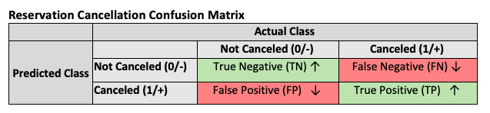
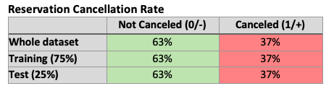


Business Objectives
Impact of customer-initiated cancellations
Revenue and profitability
Supply chain ripple effect
Sensitivity (True Positive Rate): TP/(TP+FN)
Probability of correctly predicting a cancellation while the booking was actually canceled
Specificity (True Negative Rate): TN/(TN+FP)
Probability of correctly predicting non-cancellation while the booking was actually not cancelled
False negative scenario has the BIGGEST potential impact to hotel owners (“no-shows”)
False positive also concerning (customers predicted to cancel, but actually “show”)
FOCUS AREA
Models focused on maximizing sensitivity (true positive rate) and specificity (true negative rate) for predicting cancellations, but emphasized specificity over sensitivity

Slide 8
Part 3 - Data Exploration - Tableau Observations

Slide 9
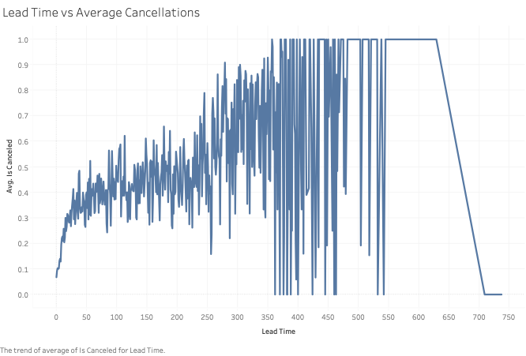
Lead Time Impact
Longer lead times lead to higher cancellation rate

Slide 10
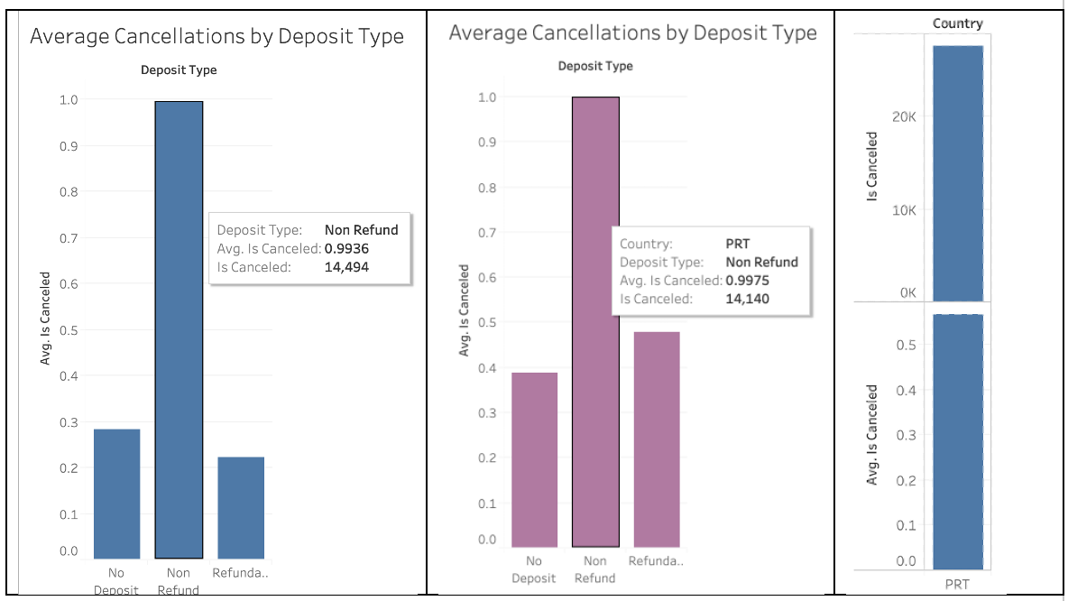
Deposit Type Impact
Some deposit types have a higher cancellation rate

Slide 11
Cancellation History Impact
There is a trend between the number of previous cancellations, and the actual cancellations

Slide 12
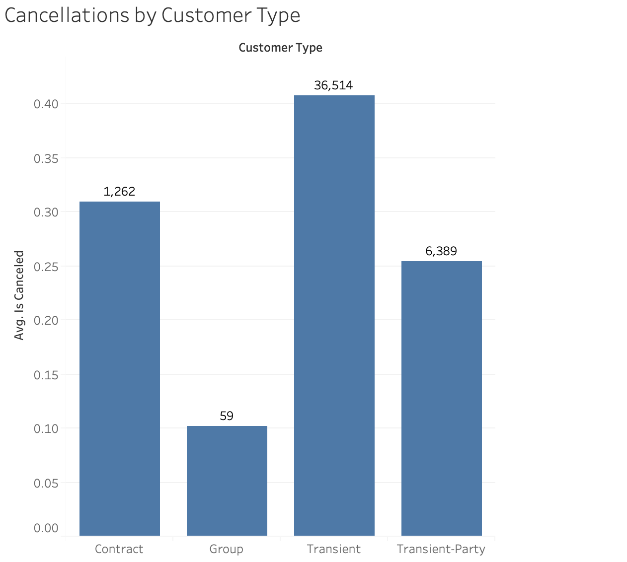
Customer Type Impact
Transient customer types have the highest cancellation rates

Slide 13
Part 4 - Data Manipulation

Slide 14
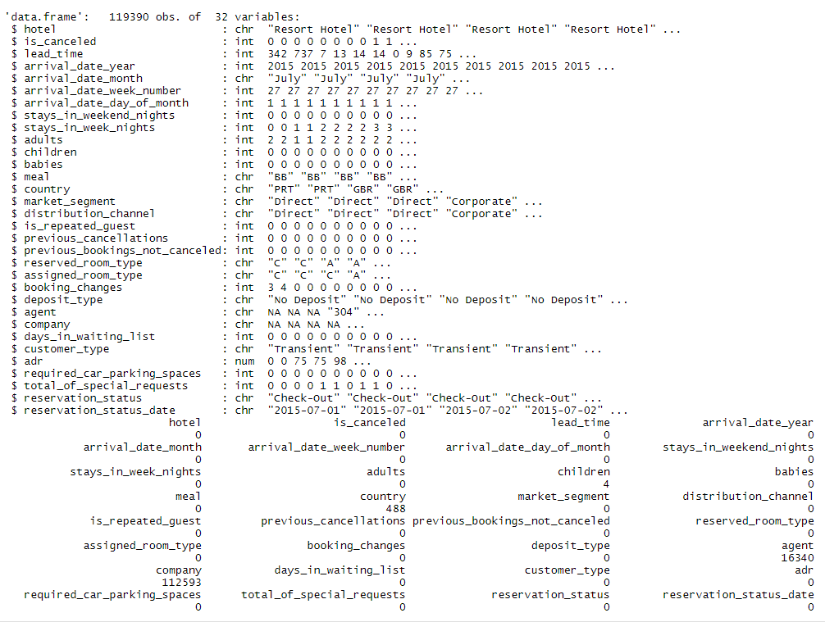

Data Cleaning
Convert NULL to NA
Drop variables with large number of NA
Country, agent, and company
Convert variables to factor
hotel, arrival date(year, month, week number, day of month), meal, country, market segment, distribution channel, deposit type, customer type.
Convert 4 NAs in Children variable to 0
Convert “Undefined” in Meal to “SC”
Add a new column “room_type_diff”
If the reserve room type is the same as assign room type, then room_type_diff is 1, 0 otherwise.
Drop reservation status and reservation status date
Note:
Additional variables will be dropped in some predictive models, due to the dimensionality limit of the model.

Slide 15
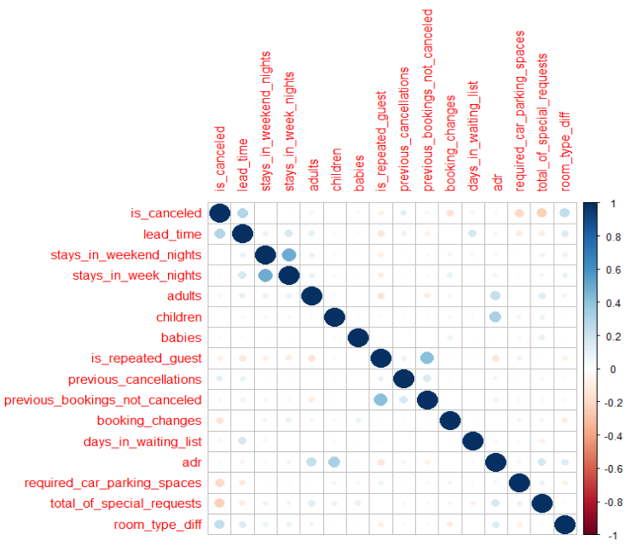
Data Correlation and Partition
Examine the correlation between numeric variables
Data partition
Random seed (123)
Train: 75%
Test: 25%

Slide 16
Part 5 - Predictive Models

Slide 17
Association Rules
Logistic Regression
K-Nearest Neighbors
Random Forests
Classification Trees
Top rule associated with cancellations by Lift
No Babies
No previous Cancellations
Deposit Type
Non-Refundable
Transient Customer Type

Slide 18
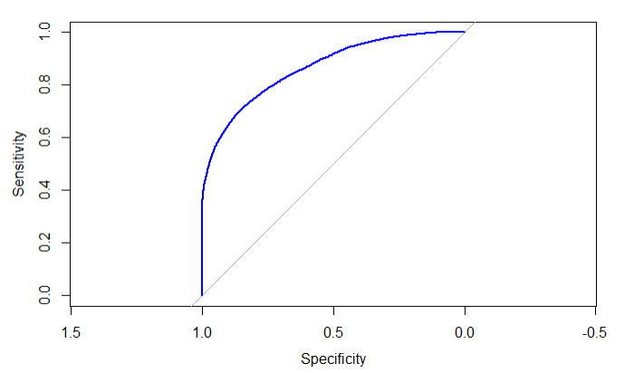
Association Rules
Logistic Regression
K-Nearest Neighbors
Random Forests
Classification Trees
Auto Variables Selection (Both)
Drop days in waiting list
AIC = 74359
Cutoff value: 0.5
Overall Accuracy: 80.8%
Sensitivity (TPR): 61.3%
Specificity (TNR): 92.3%
AUC: 0.8653
Variables with Low P-value:
Lead time
Room type difference
total of special requests
adr
Deposit type
booking changes
previous cancellations
Arrival date month
Arrival date week number
 | Actual Class
Predicted Class |  | Not Canceled (0/-) | Canceled (1/+)
 | Not Canceled (0/-) | 17,380 | 4,267
 | Canceled (1/+) | 1,453 | 6,747

Slide 19
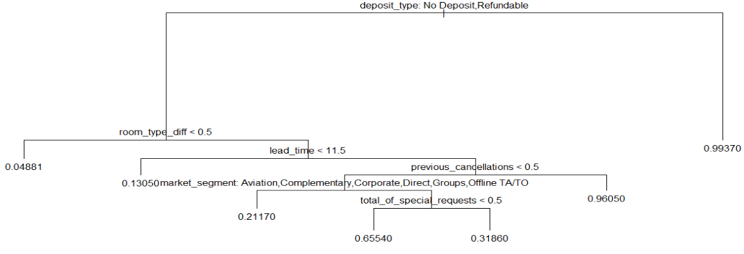
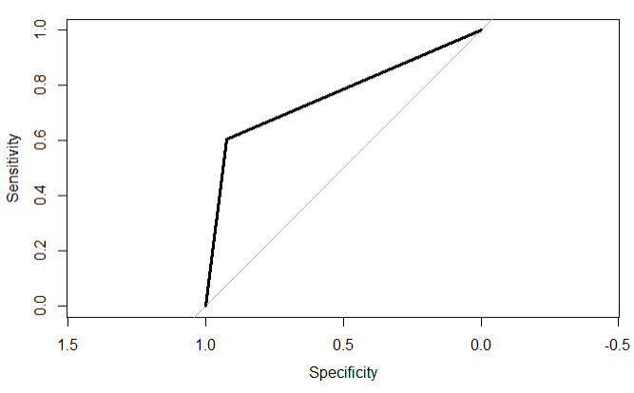
Association Rules
Logistic Regression
K-Nearest Neighbors
Random Forests
Classification Trees
Cutoff Value: 0.5
Overall Accuracy: 80.5%
Sensitivity (TPR): 60.3%
Specificity (TNR): 92.2%
AUC: 0.7629
Variables for Classification:
deposit type
room type difference
lead time
previous cancellations
market segment
total special requests
 | Actual Class
Predicted Class |  | Not Canceled (0/-) | Canceled (1/+)
 | Not Canceled (0/-) | 17,371 | 4,367
 | Canceled (1/+) | 1,462 | 6,647

Slide 20
Association Rules
Logistic Regression
K-Nearest Neighbors
Random Forests
Classification Trees
 | Actual Class
Predicted Class |  | Not Canceled (0/-) | Canceled (1/+)
 | Not Canceled (0/-) | 16,284 | 4,252
 | Canceled (1/+) | 2,465 | 6,847
The value of k used: K=13
Performance results:
Overall Accuracy: 77.5%
Sensitivity (TPR): 61.7%
Specificity (TNR): 86.9%

Slide 21
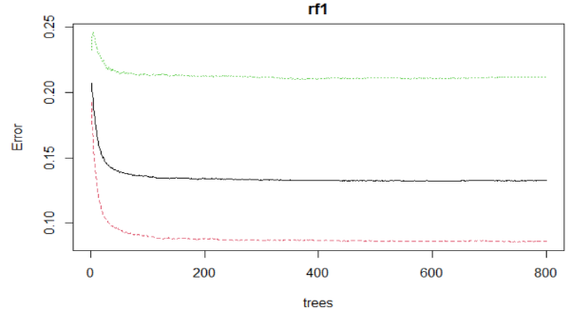
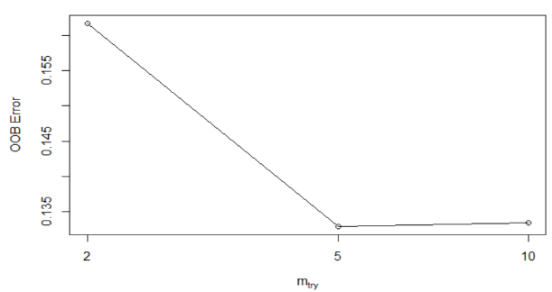
Association Rules
Logistic Regression
K-Nearest Neighbors
Random Forests 1
Classification Trees
Tuning parameter ntree (Number of trees to grow) = 300
Tuning parameter mtry (Number of variables randomly sampled as candidates at each split) = 5
ntree | Overall Accuracy | Sensitivity (TPR) | Specificity (TNR) | AUC
800 | 0.8668 | 0.7810 | 0.9176 | 0.9313
500 | 0.8667 | 0.7809 | 0.9174 | 0.9312
300 | 0.8673 ↑ | 0.7815 | 0.9181 ↑ | 0.9309

Slide 22
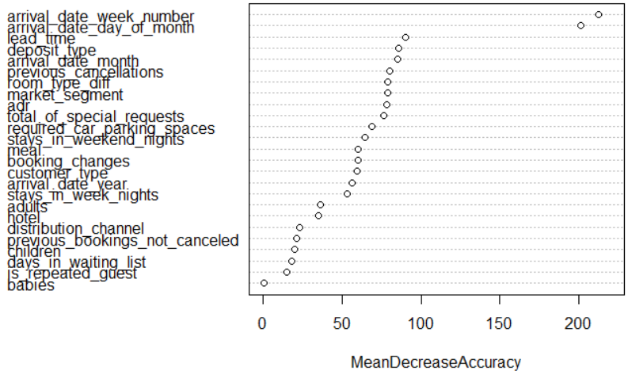
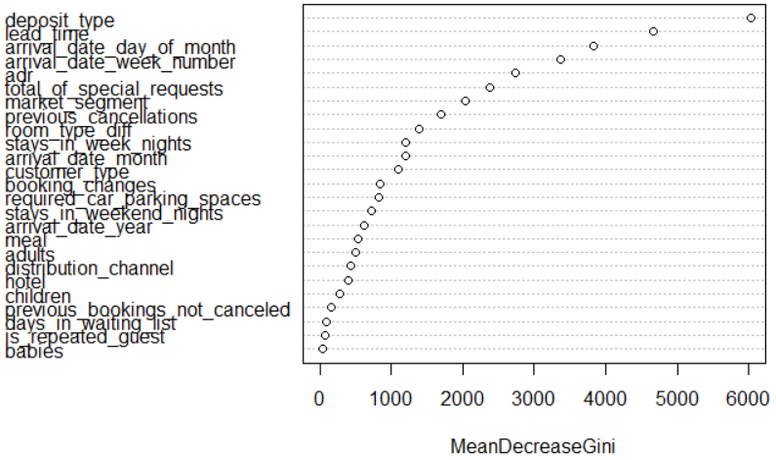
Association Rules
Logistic Regression
K-Nearest Neighbors
Random Forests 2
Classification Trees
The final model with tuning parameters
ntree = 300, mtry = 5
Cutoff value: 0.6
Performance results:
Overall Accuracy: 86.4%
Sensitivity (TPR): 72%
Specificity (TNR): 94.9%
 | Actual Class
Predicted Class |  | Not Canceled (0/-) | Canceled (1/+)
 | Not Canceled (0/-) | 17,800 | 3,108
 | Canceled (1/+) | 949 | 7,991

Slide 23
Evaluation of Models
Model | Overall Accuracy | Sensitivity (TPR) | Specificity (TNR) | AUC
Logistic Regression | 80.8% | 61.3% | 92.3% | 0.8653
Classification Trees | 80.5% | 60.3% | 92.2% | 0.7629
K-Nearest Neighbors | 77.5% | 61.7% | 86.9% | NA
Random Forests | 86.4% | 72.0% | 94.9% | 0.9309
Importance of Variables
All models
Deposit type
Association Rules
Similarity: number of previous bookings not canceled and deposit type
Random Forests &
Logistic Regression
Arrival date
Average daily rate
Number of previous bookings cancelled
Room type difference
Lead time
Total special requests
Difference: customer type and number of babies

Slide 24
Model Deployment Use Case
Customer requests new booking
No
Reject Order
Yes
Are all rooms booked?
Are existing orders likely to cancel?
Overbooking Capacity Reached?
Yes
Yes
No
No
Accept Order
Overbook & Accept Order

Slide 25
Part 6 - Recommendations

Slide 26

Recommendations
Check out the paper for more!
Use of our predictive models to better manage capacity
One of many recommendations provided
Overbook (double book) customers meeting identified risk factors identified
Best interest of hotels
Follow decision tree
Defined threshold for overbooking (e.g. 25%)
Autogenerated emails to customers requesting confirmation of stay (e.g. 48 hours prior to check in)
No response 24 hours prior to check in, then customer “bumped” by guest with a higher “value score”
Value score based on weighted cancellation risk factors, value of the stay, and booking history
Customers with the higher value score “bump” less valued customers
Loosely based off airline bump and compensation policies
Disclaimer: Considered a baseline which can be catered based on varying business philosophies on risk and reward, as well as hotel-specific historical data
.

Slide 27
Supply Chain Implications
More stable room utilization rate allows hotels to fully utilize support staff
E.g. cleaning and restaurant employees
Better forecast demand for raw materials and finished goods
Leads to more consistent purchase orders, or establishing long-term contracts for better pricing and terms
Now a predictable forecast
Can buy non-perishable items in bulk
Ensure less spoilage/waste of perishable items
Bullwhip effect (created by large swings in demand from cancellations)
Now minimized with more stable and smoothed demand

Slide 28
Part 7 - Conclusion

Slide 29
Conclusion
Applied many of the statistical methodologies covered in class to a real-world supply chain issue
Hotels face a significant problem with customer-initiated cancellations
Cancellation rate of 37% equates to a substantial under-utilization of capacity
Haphazard cancellations create a lumpy demand pattern
Ripples through the supply chain with detrimental effects
Our predictive models offer a solution to hotels!
Anticipating which customers will likely cancel; employing proactive strategies to ensure demand
Provided strategies to reduce customer-initiated cancellations
Result: a higher, as well as more consistent, room utilization rate

Slide 30

Thank you for the fun and intriguing journey!
Regards, Karan Modi, Folarin Omotoriogun , Mark Tegeler,
Shih-Yuan Wang, and Yujie Wen

